Slide 1
Agile Software Development

Slide 2
Why Agile?
Agile proponents believe
Current software development processes are too heavyweight or cumbersome
Too many things are done that are not directly related to software product being produced
Current software development is too rigid
Difficulty with incomplete or changing requirements
Short development cycles (Internet applications)
More active customer involvement needed

Slide 3
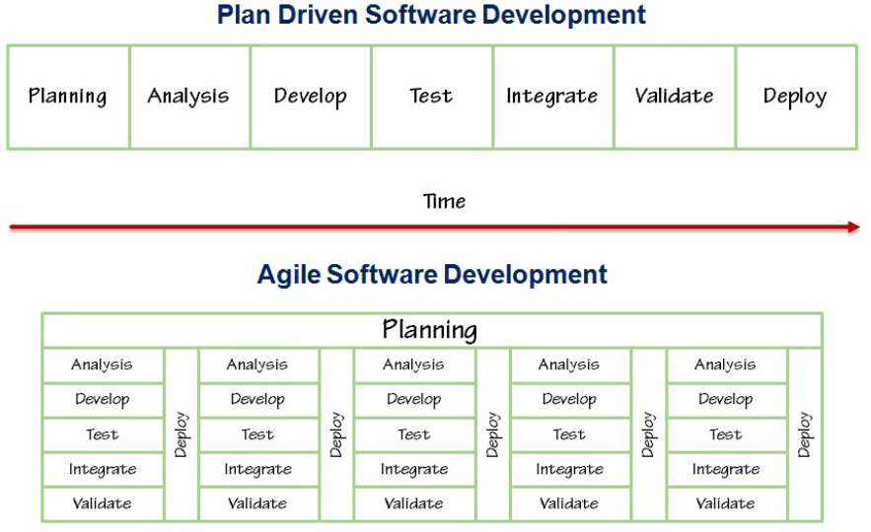
Comparison

Slide 4
Agile Manifesto
Individuals and interactions over processes and tools
Working software over comprehensive documentation
Customer collaboration over contract negotiation
Responding to change over following a plan
Principles behind agile manifesto
http://agilemanifesto.org/principles.html

Slide 5
Scrum Characteristics
Self-organizing teams
Product progresses in a series of month-long “sprints”
Requirements are captured as items in a list of “product backlog”
No specific engineering practices prescribed
Uses generative rules to create an agile environment for delivering projects
One of the “agile processes”

Slide 6
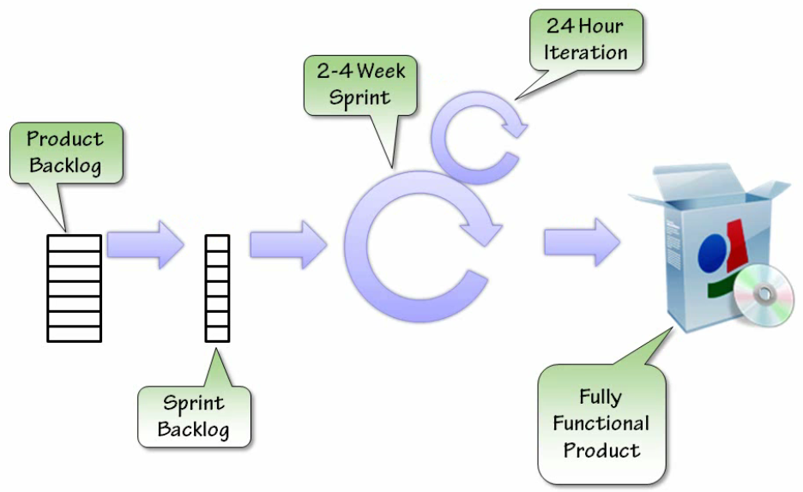
SCRUM

Slide 7
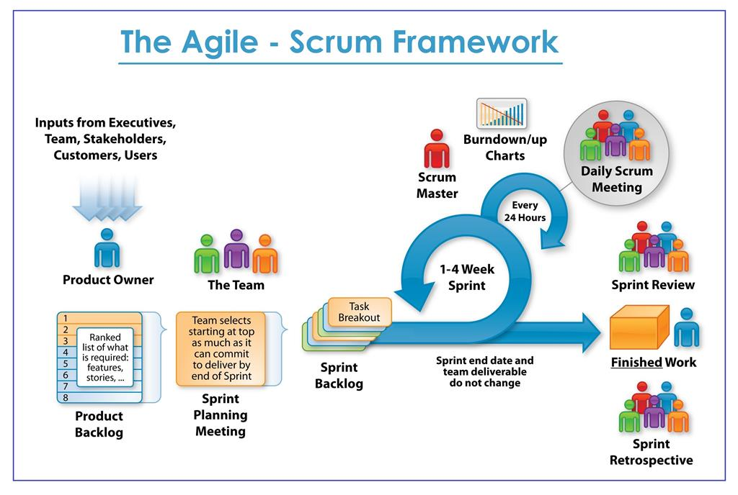

Slide 8
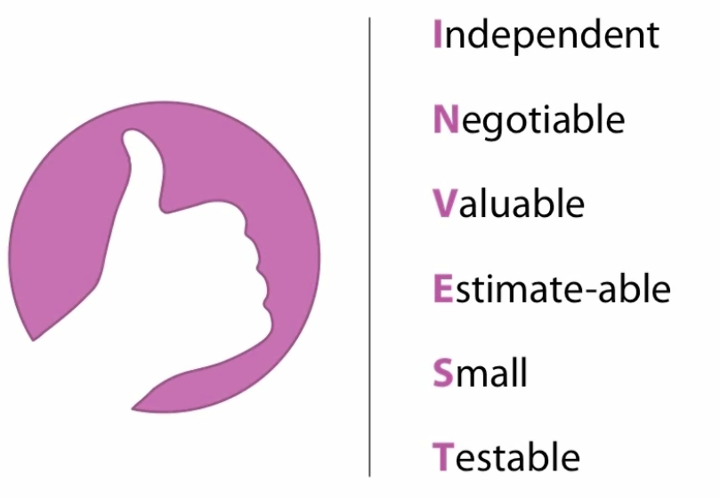
User Story
As a (role), I want (feature), so that (benefit)

Slide 9
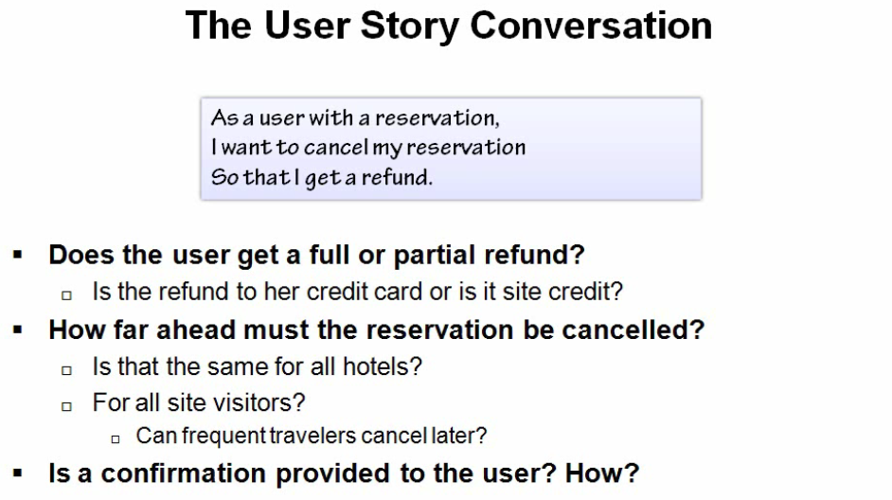

Slide 10
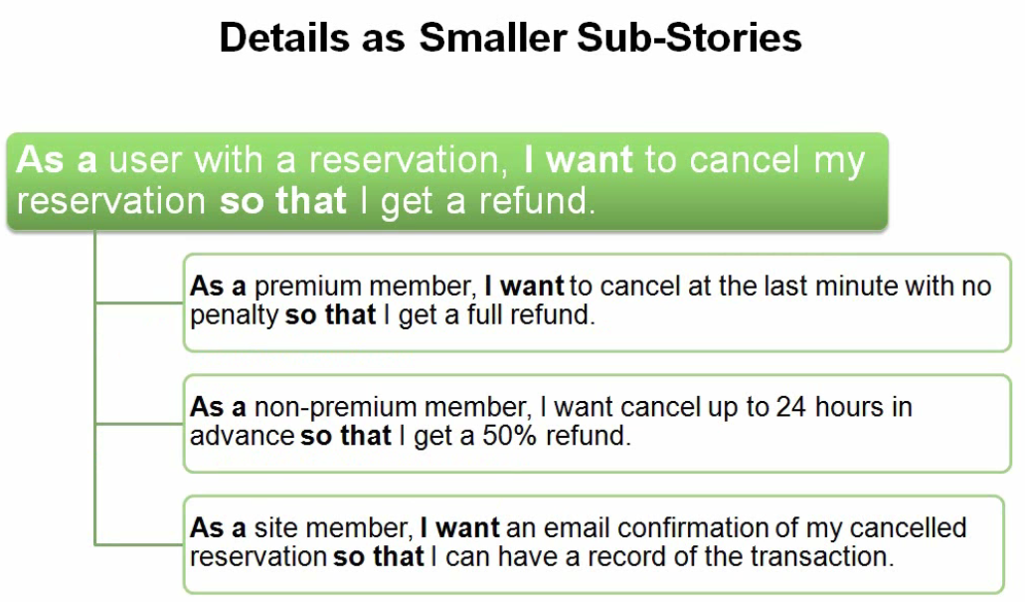

Slide 11
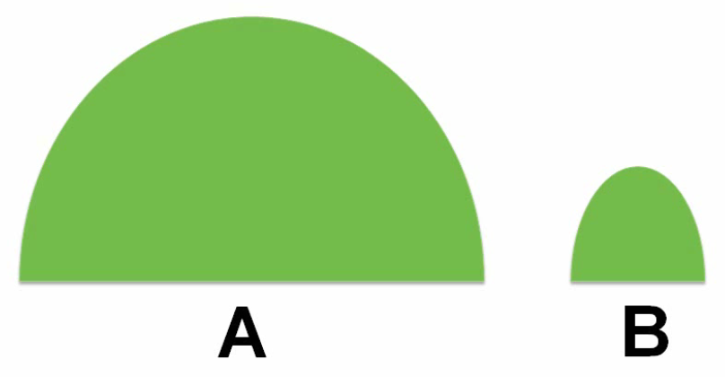

Relative Estimation

Slide 12
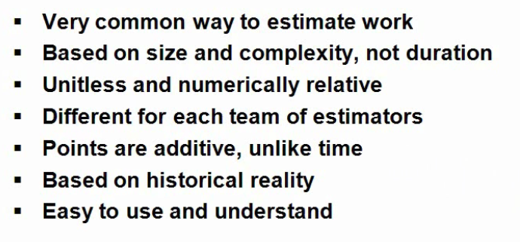
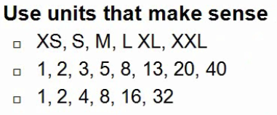
Story Points

Slide 13
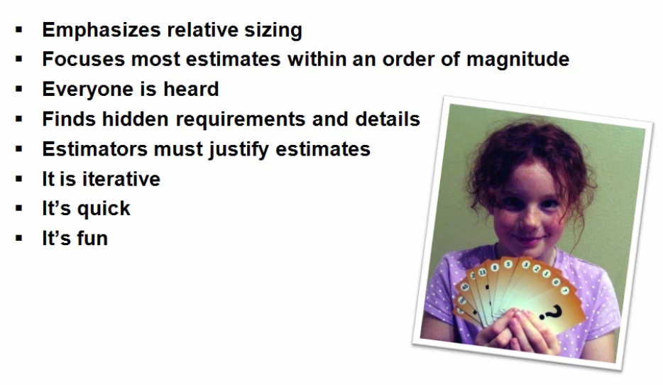
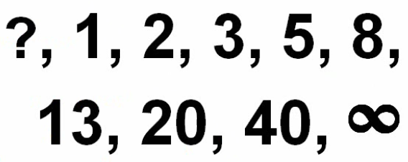
Why Planning Poker works

Slide 14
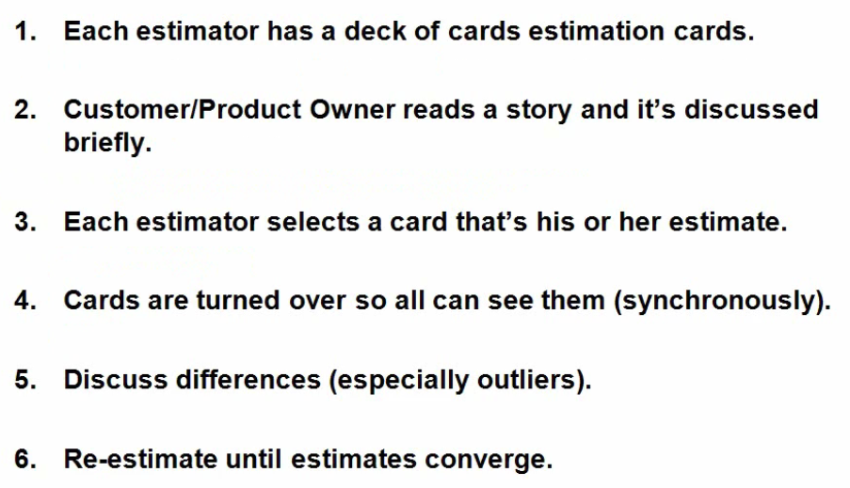
Planning Poker Rules

Slide 15
Planning Poker
 | Round 1 | Round 2 | Round 3
Arun | 8 | 13 | 8
Raj | 5 | 5 | 5
Sonia | 3 | 5 | 5
Dave | 1 | 3 | 3
Mark | 8 | 5 | 5
Options for handling conflicts
Wait for convergence (most preferred)
Average the estimates
Toss out High and Low (low morale)
Send the item back for re-definition

Slide 16
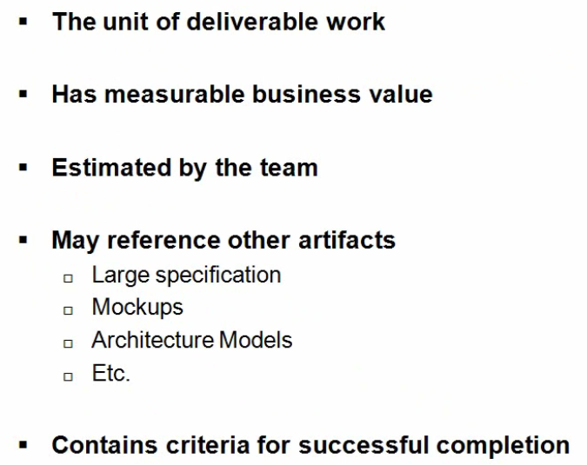
Product Backlog item

Slide 17
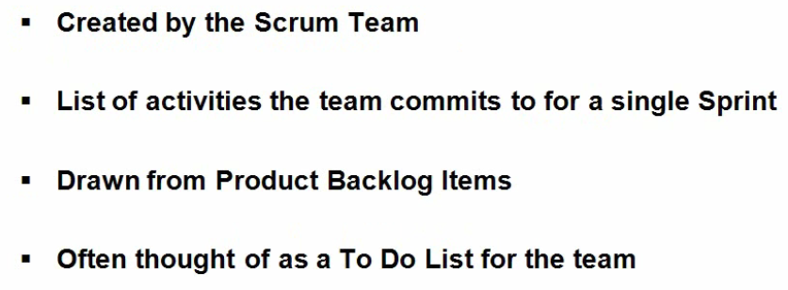
Sprint Backlog

Slide 18
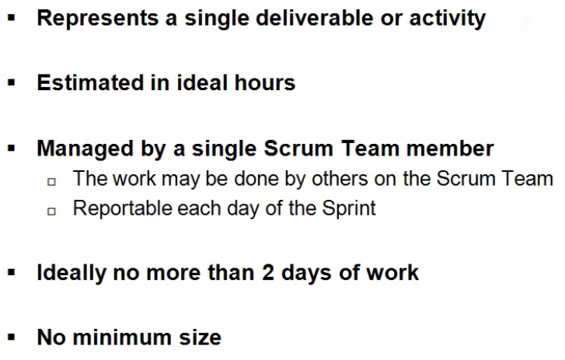
Sprint Backlog item

Slide 19
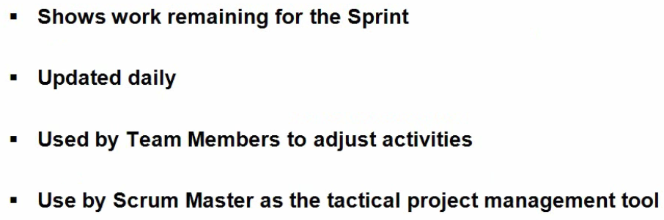
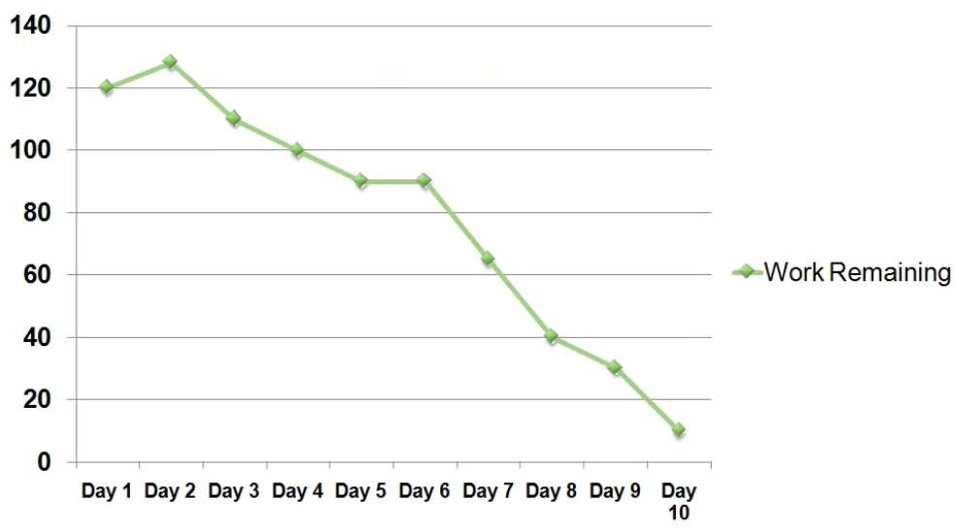
Sprint Burn down Chart

Slide 20
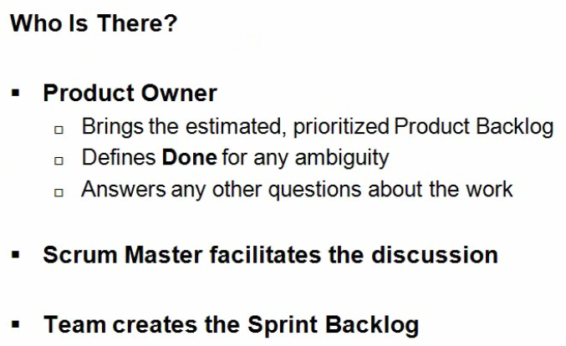
Sprint Planning Meeting

Slide 21
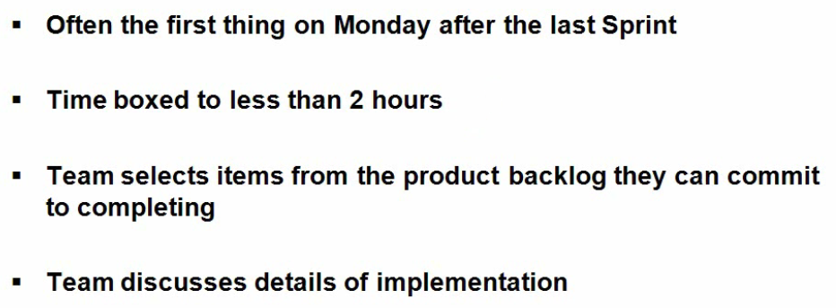
Sprint Planning Meeting

Slide 22
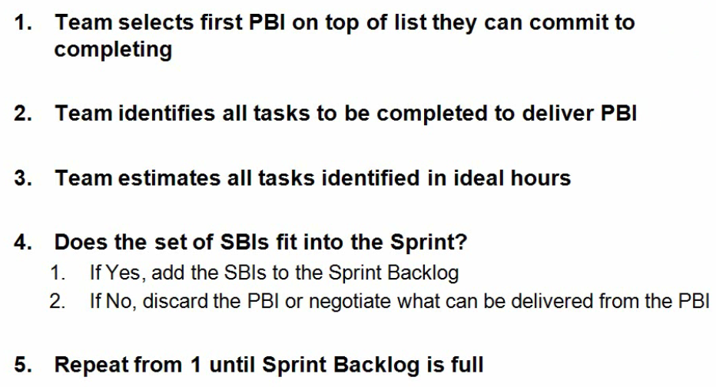
Creating the Sprint Backlog

Slide 23
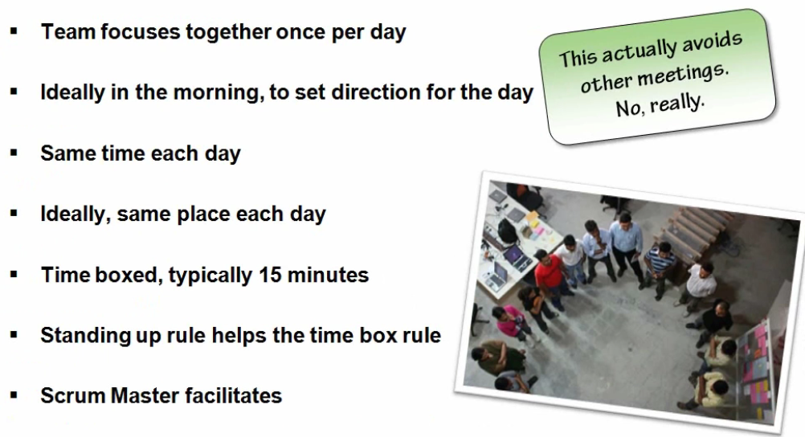
The Daily Scrum

Slide 24
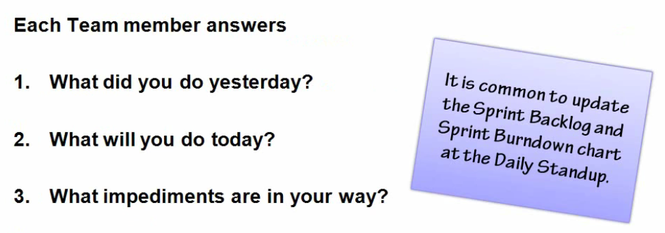
The Daily Scrum

Slide 25
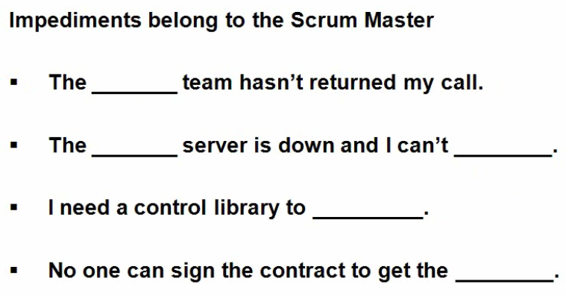
Handling impediments

Slide 26
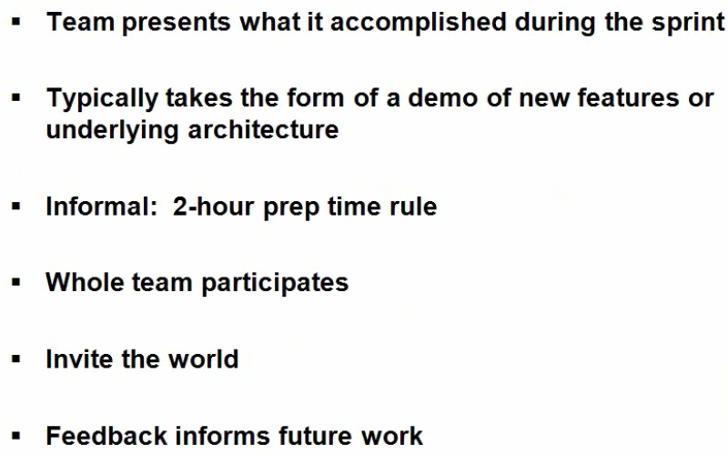
The Sprint Review

Slide 27
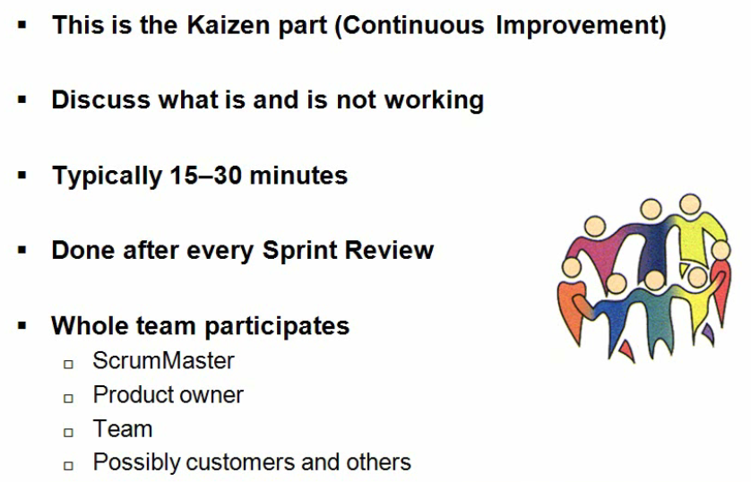
The Sprint Retrospective

Slide 28
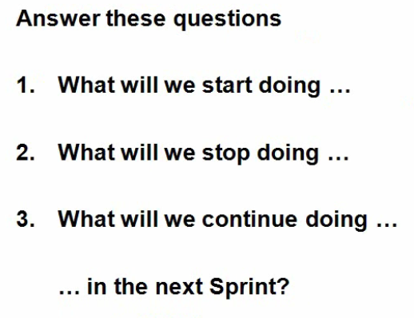
Sprint Retrospective

Slide 29
Kanban
Means “Visual” + “Board” in Japanese
Rules:
Visualize your work
Limit your work in process

Slide 30
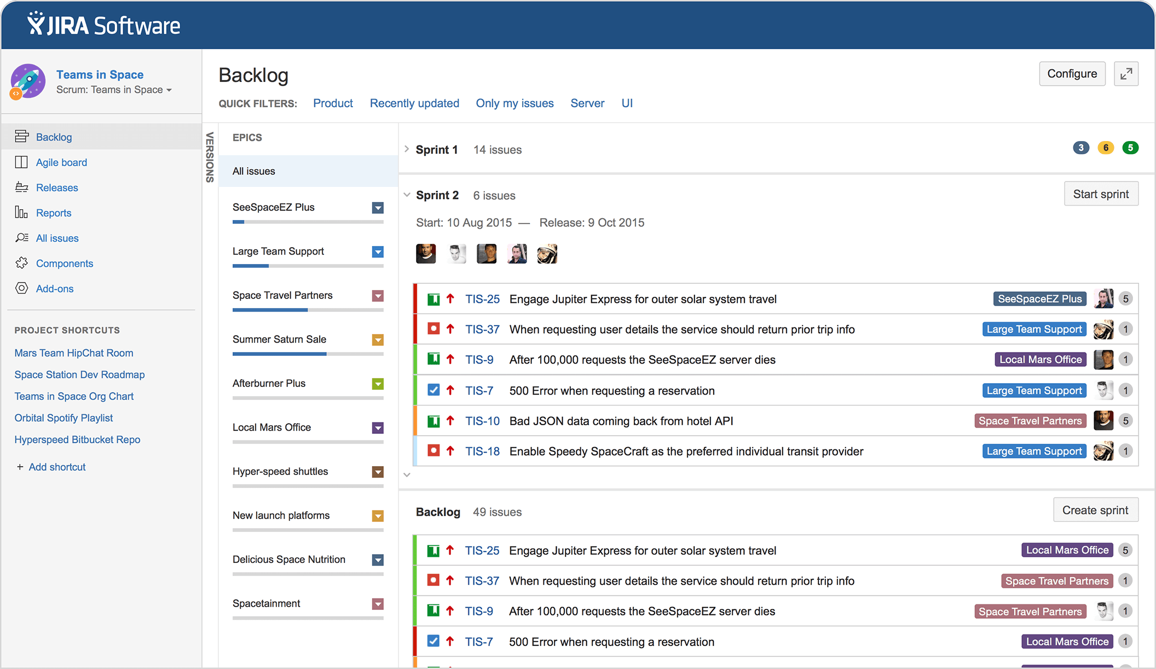
JIRA – Agile Project Management

Slide 31
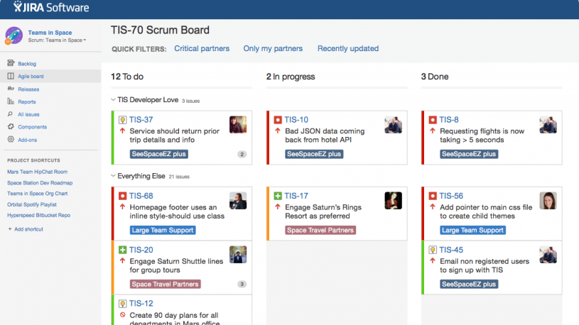
JIRA – Agile Project Management

